Slide 1



AjeditsDB
Online Freelancing
Video Editing Business
on Fiverr
By AJ Luthra

Slide 2
Ajeditsdb
Ajedits26 is a freelancing video editing online business hosted on fiverr, and it offers viral short-form and long-form edits with clean animations and motion graphics.
The software I use to edit every project is called Davinci Resolve.
It is used to take in data to simulate how fiverr is used:
The client makes an account and joins fiverr
The client searches a digital service and chooses a freelancer
Then a client can choose a freelancer to complete a service for them
The client can choose a package that have different price ranges depending on how big the job is
Then the client can place an order for the specified package of the service
They can use their payment method of choice, and remain in constant contact with the freelancer through real-time messages
Then the client can leave a review for the freelancer based on how good a job they did or whether they weren’t satisfied by the job

Slide 3
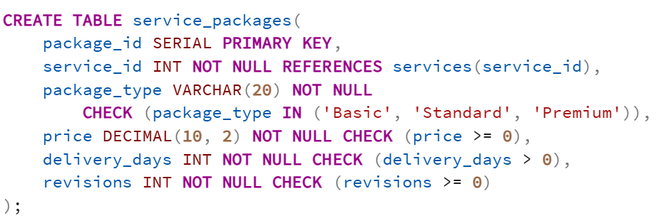
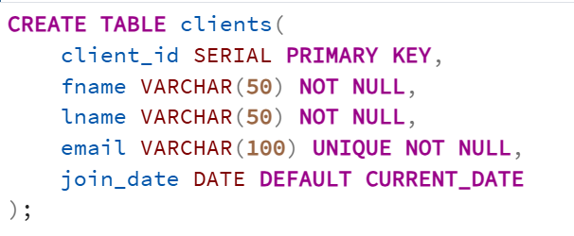
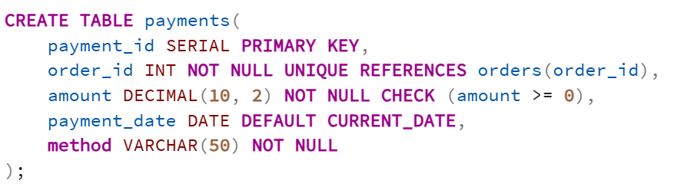
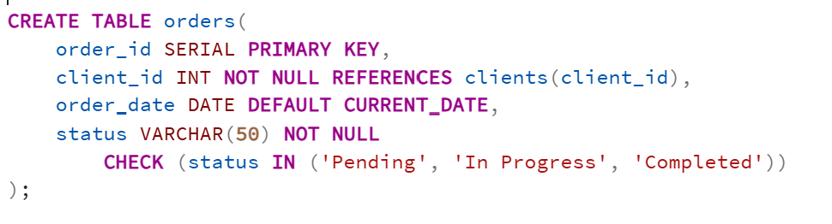
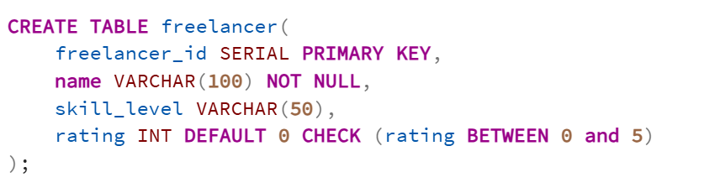
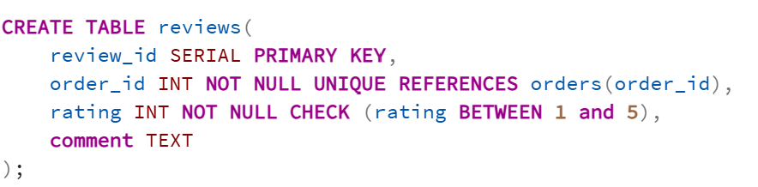
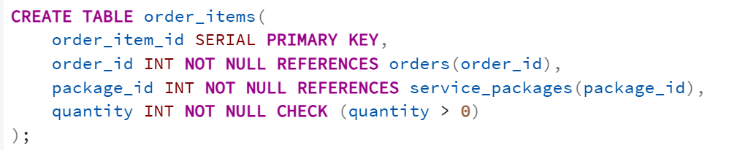
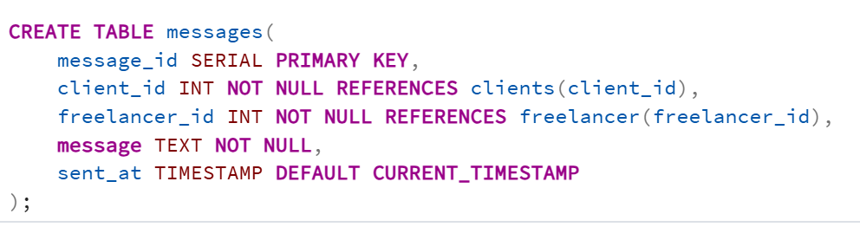
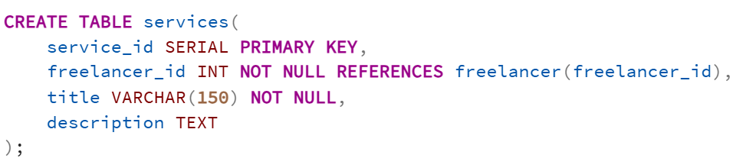
Tables

Slide 4
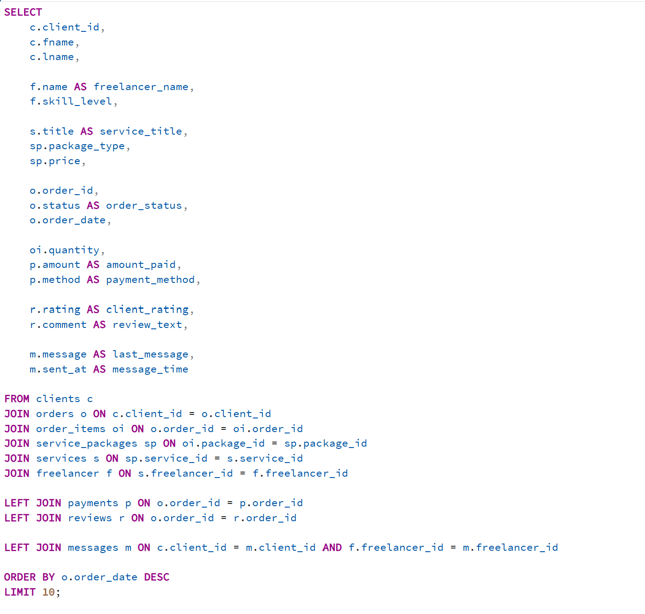

Slide 5
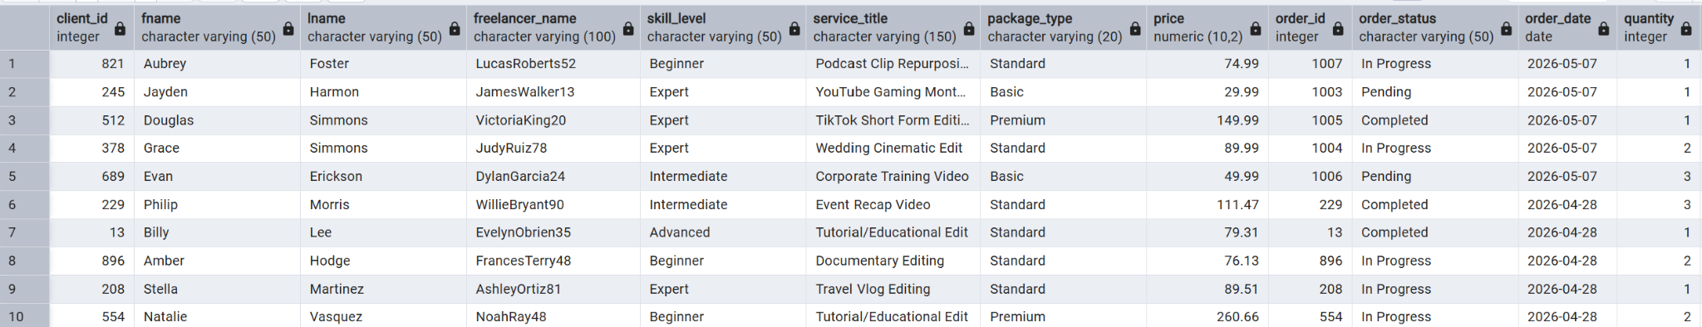
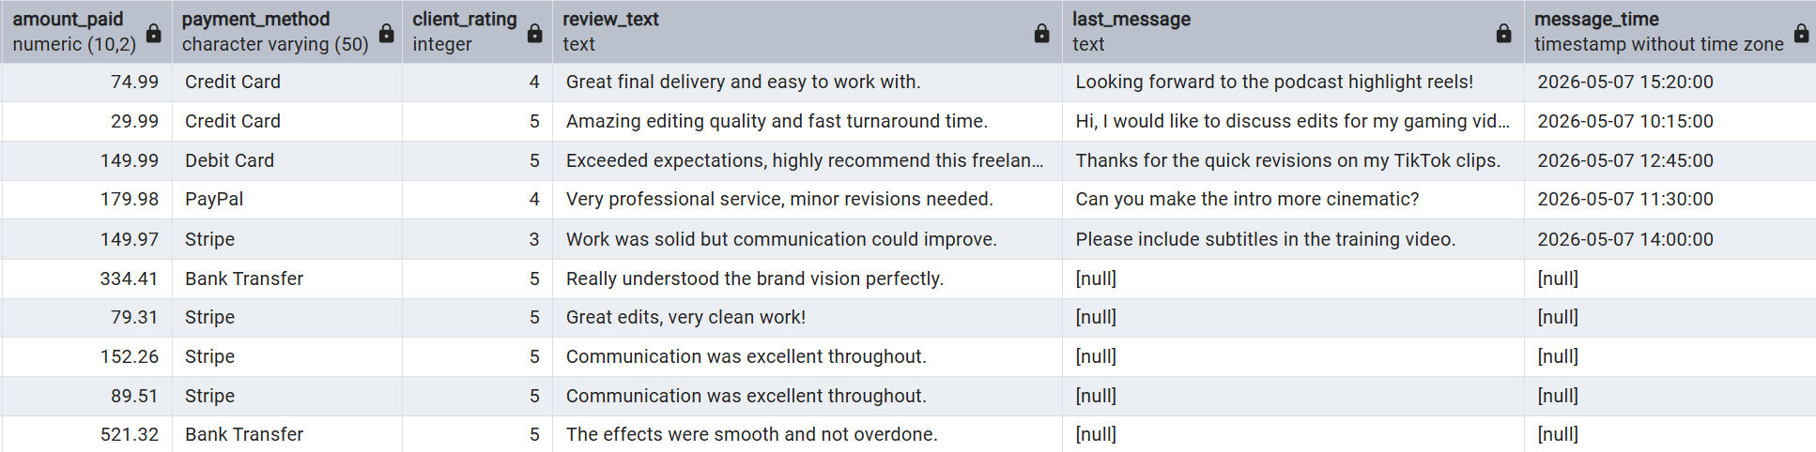
Data (Using Joins to view all data in one data table)

Slide 6
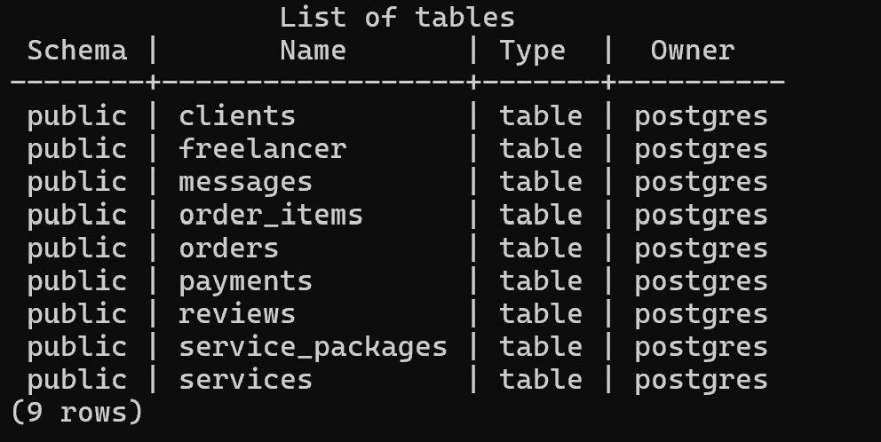
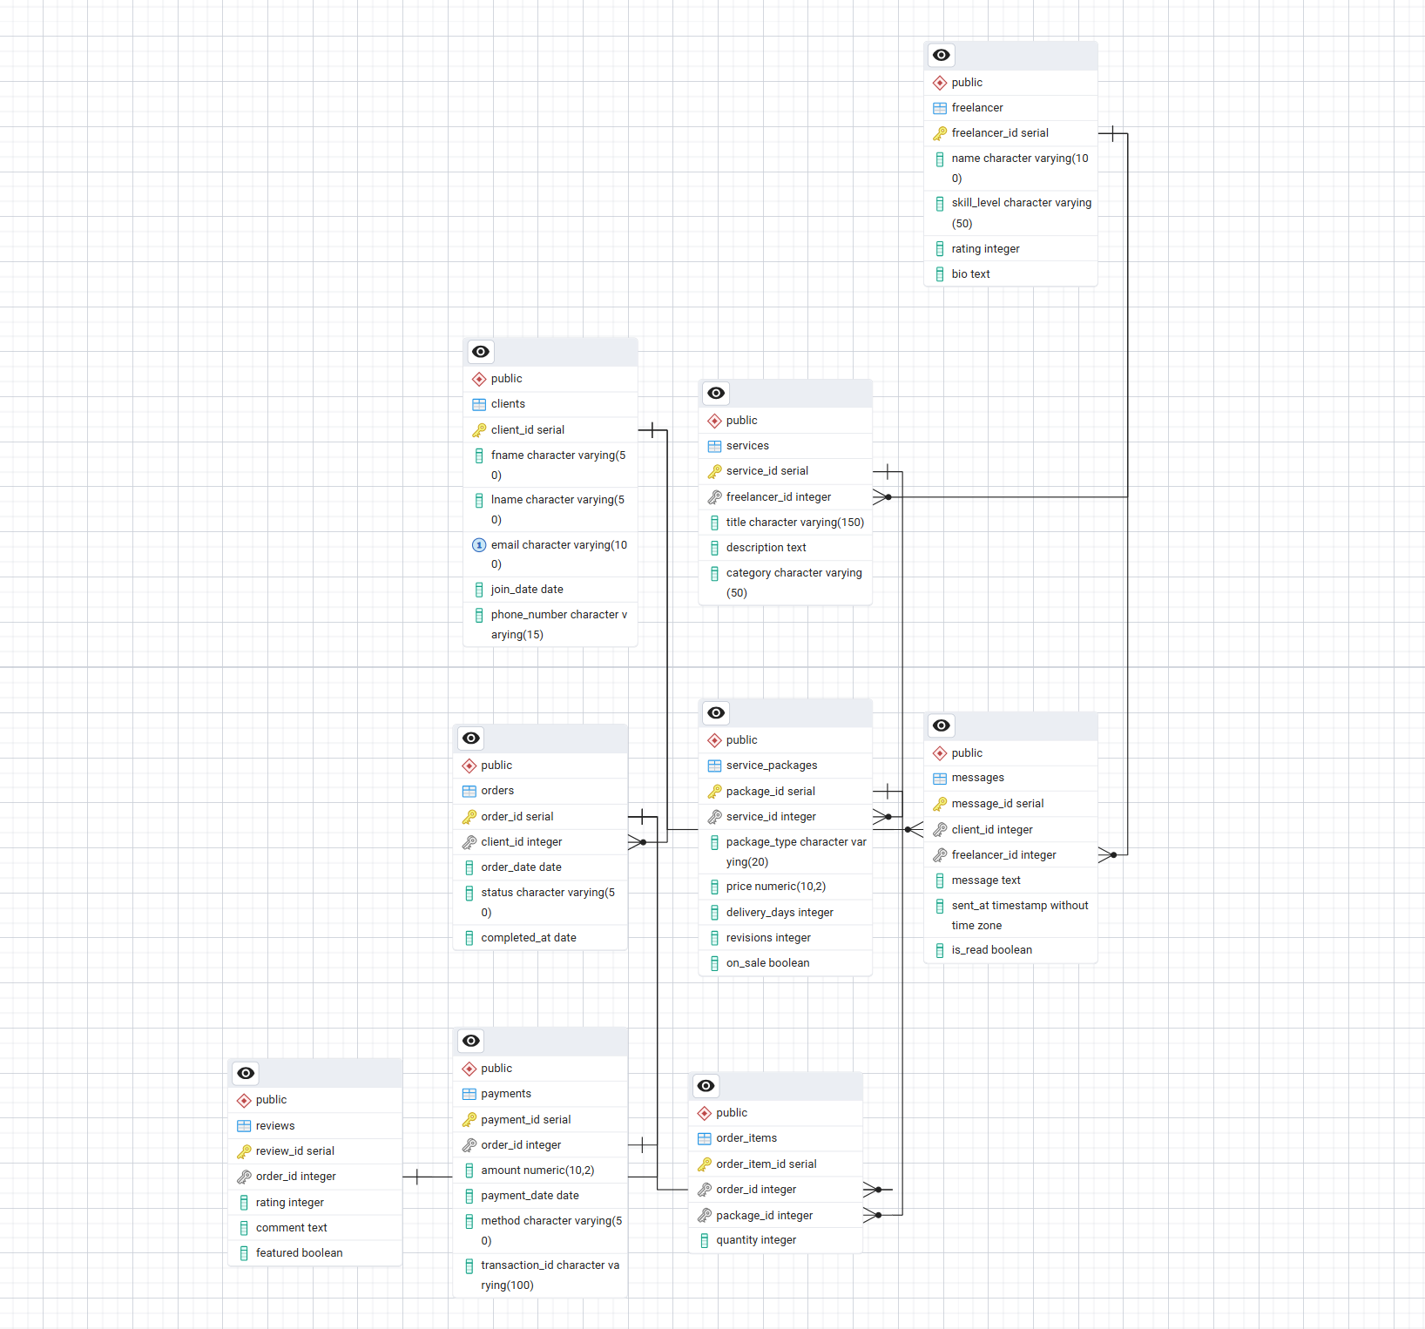
Tables

Slide 7
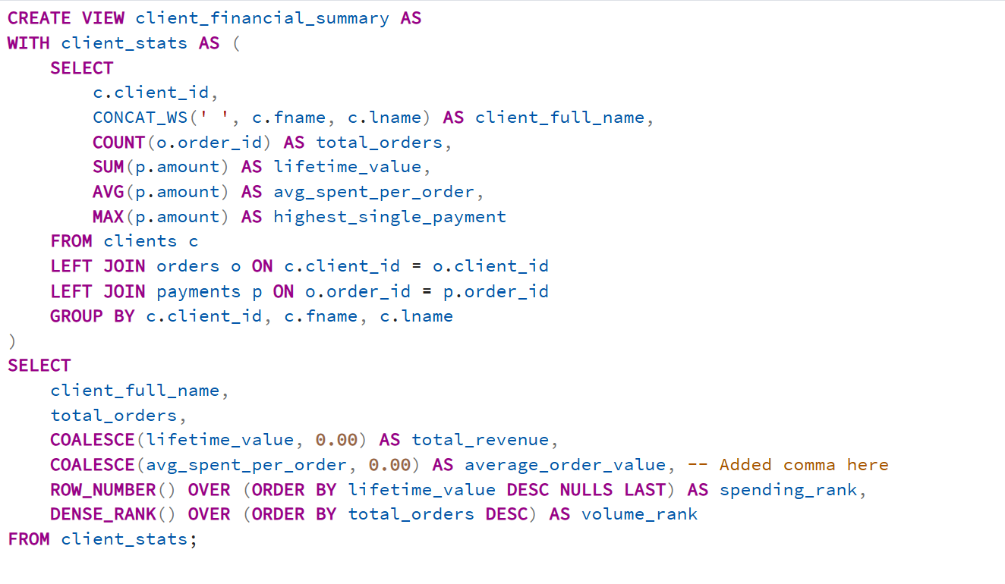
Queries Part 1
This query is using CTE and Window Functions to transform transaction data from every order to a structured business report.

Slide 8
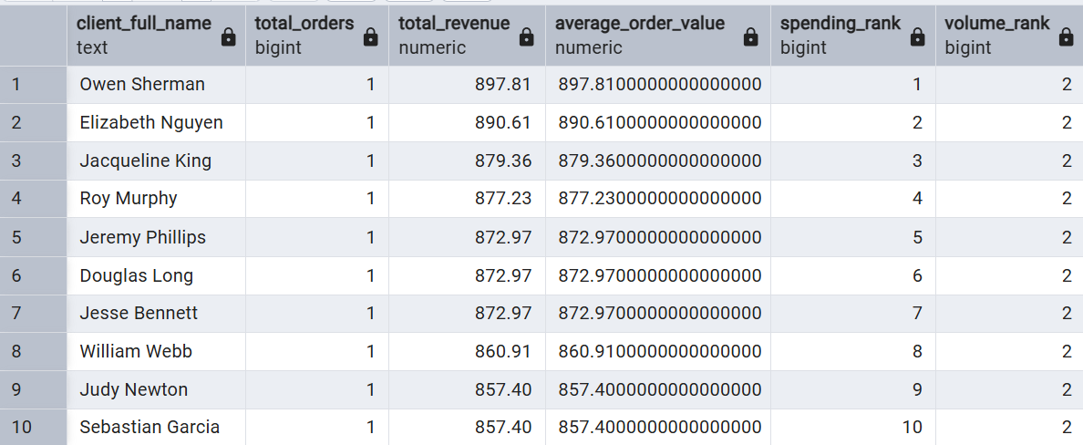
Data table for queries part 1

Slide 9
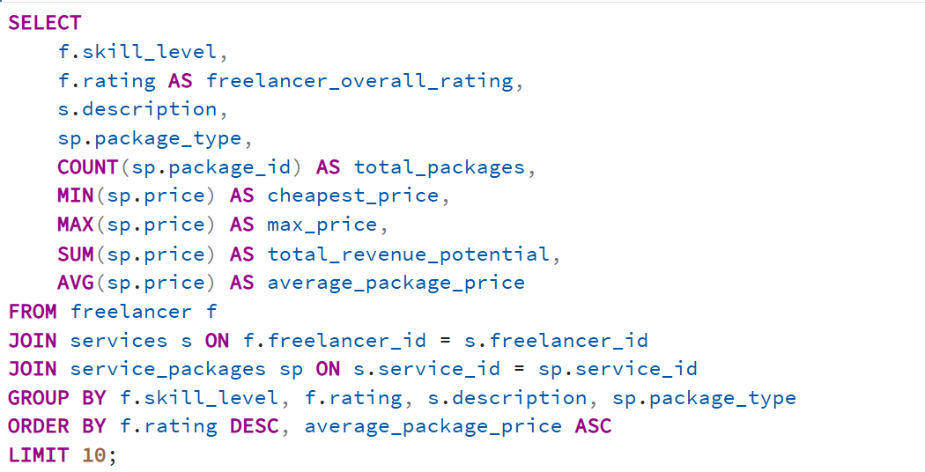
Queries part 2
This query aggregates and analyzes pricing data to determine which service package is the best option for each client
I grouped them based on skill level and rating of the freelancer and the package type
I used minimum, maximum, sum, count, and average to calculate metrics

Slide 10
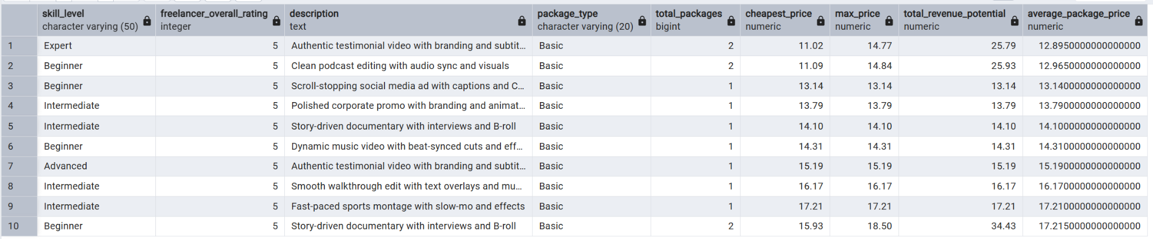
Data table for queries part 2

Slide 11
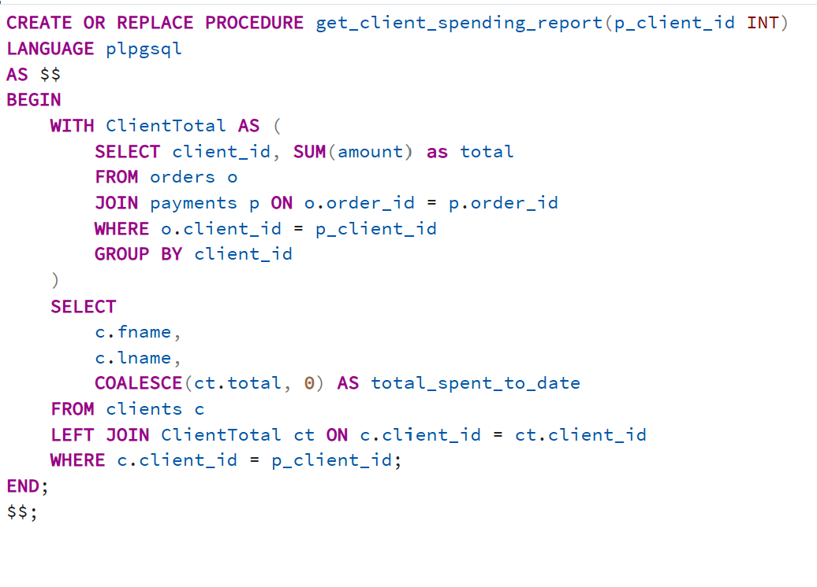
Queries part 3
This procedure generates a financial summary for a specific client if they have not made any transactions yet.
Calculates the sum of all their completed order payments.
It also uses a CTE to aggregate data from orders and payments tables and then joins the results with the clients table.

Slide 12
Questions?
Thank you for listening!

